Slide 1
PERSONALIZED HEALTH CARE MOBILE APPLICATION
BY
SAFNA.PP
Guided by
PRIYA.JD
Assistant Professor
Master of computer applications
MES College of Engineering,Kuttippuram

Slide 2
INTRODUCTION
A personal healthcare mobile application is a digital tool that helps individuals manage their health and wellness goals. The application allows users to track various health metrics such as physical activity, nutrition, sleep, and mood. Users can set goals and receive personalized recommendations to help them achieve their desired outcomes.
The application utilizes various technologies, such as wearables and sensors, to collect data about the user's health and fitness activities. The data is then processed and analyzed using machine learning algorithms to provide meaningful insights and recommendations.
The application also provides features such as medication reminders, appointment scheduling, and telemedicine consultations with healthcare professionals. The platform is designed to promote engagement and behavior change by providing motivational messages, gamification, and social support features.

Slide 3
Cont…
In summary, a personal healthcare mobile application is a comprehensive platform that helps individuals manage their health and wellness goals by providing data tracking, personalized recommendations, and access to healthcare professionals. The application can potentially improve health outcomes and promote healthy lifestyles.
Predicting the health system using BMI and other physical conditions can be achieved through a combination of data analysis and machine learning techniques. BMI, which is a measure of body fat based on height and weight, can provide insights into a person's overall health status.
Other physical conditions that can be considered include blood pressure, cholesterol levels, blood sugar levels, and any existing medical conditions such as diabetes or cardiovascular disease.
By collecting and analyzing data on these physical conditions, it is possible to develop predictive models that can identify individuals who are at high risk of developing certain health problems

Slide 4
EXISITING SYSTEM
The user may have to consult doctor even for small doubts and queries, a personal healthcare mobile application is a comprehensive platform that helps individuals manage their health and wellness goals by providing data tracking, personalized recommendations, and access to healthcare professionals

Slide 5
PROPOSED SYSTEM
A proposed system for personalized health care prediction using BMI could include the following components:
Data Collection: The system would collect data on a person's BMI, along with other physical measurements such as blood pressure, cholesterol levels, and family history of diseases. It would also collect information about lifestyle factors such as smoking, exercise habits, and diet. This data could be collected through a mobile app, wearable devices, or self-reported surveys.
Data Analysis: The collected data would be analyzed using machine learning algorithms to predict an individual's health status and risk factors. The analysis would identify patterns and correlations between the data points to create personalized health risk profiles for each individual.

Slide 6
Cont…
Personalized Recommendations: Based on the results of the data analysis, the system would provide personalized recommendations for each individual. This could include specific lifestyle changes, such as increasing physical activity or improving diet, or recommendations for medical interventions, such as regular check-ups or medication.
Monitoring and Feedback: The system would monitor an individual's progress over time and provide regular feedback and updates. This could include alerts or reminders to take medication, prompts to complete a daily exercise routine, or suggestions for healthy meal options.

Slide 7
Cont…
Integration with Health Care Providers: The system could integrate with health care providers to share the personalized health risk profiles and recommendations. This would allow healthcare providers to provide more personalized and targeted care to their patients.
Overall, a personalized health care prediction system using BMI could empower individuals to take control of their health and make informed decisions about their lifestyle choices. It could also help healthcare providers deliver more effective and personalized care to their patients.

Slide 8
MODULE DESCRIPTION
Hospital
Login
Add and manage doctor
Add schedule
View user
View booking
Tips management
Doctor
Login
Add prescription
Verify booking
View schedule
Chat with user

Slide 9
Cont…
User
Login
Register
View doctor
View schedule
Book
View medicine notification
Set goal and update status
View tips
Suggestions and recommendations

Slide 10
SYSTEM REQUIREMENTS
Hardware Specification
The selection of hardware is very important in the existence and proper working of any of the software. When selecting hardware, the size and capacity requirements are also important. The hardware must suit all application developments.
Processor : i3 or above.
System Bus : 32 Bit or 64 Bit
RAM : 4GB or Above
HDD : 500 GB or Above
Monitor : 14”LCD or Above
KeyBoard : 108 Keys
Mouse : Any Type of mouse
Mobile : Android supported mobile phone

Slide 11
Cont…
Software specification
One of the most difficult tasks is selecting software ,once the system requirement is find out then we have to determine whether a particular software package fits for Those System requirements. This section summarizes the application requirement.
Operating System : Windows 8 or above
Front End : Android, Python
Back End : SQLyog
IDE : Android Studio /JetBrains PyCharm

Slide 12
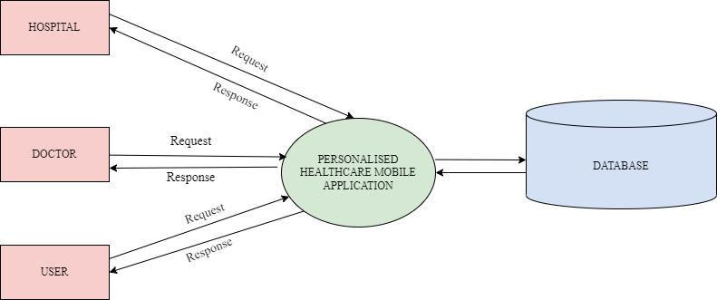
DATA FLOW DIAGRAM LEVEL 0

Slide 13
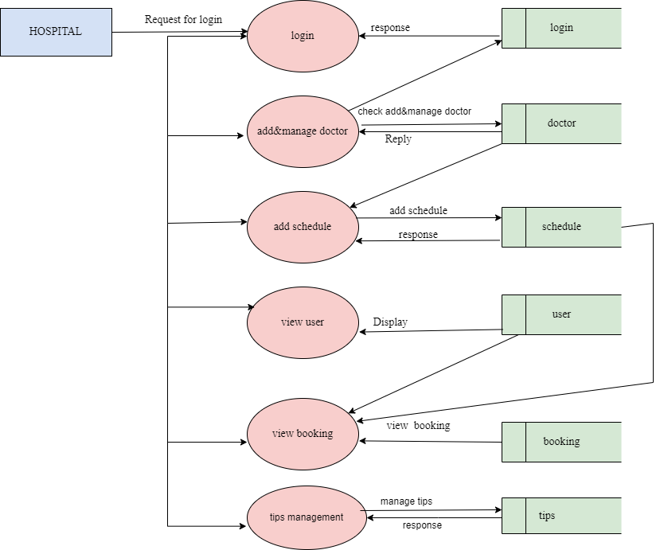
LEVEL 1

Slide 14
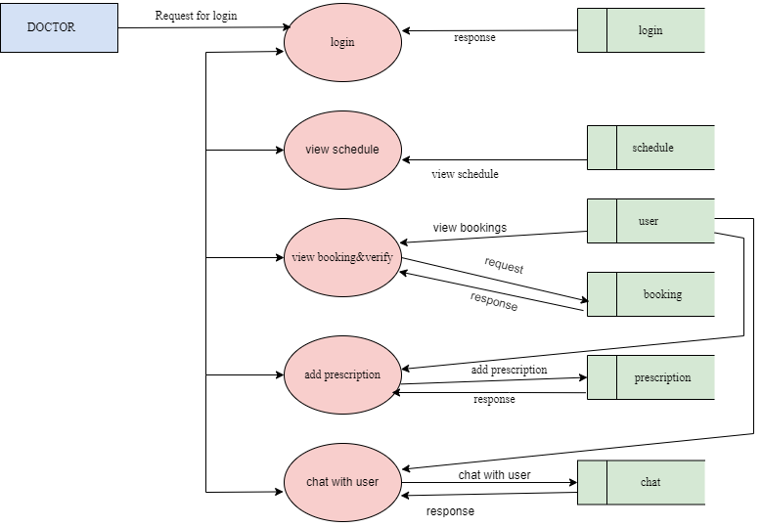
LEVEL 2

Slide 15
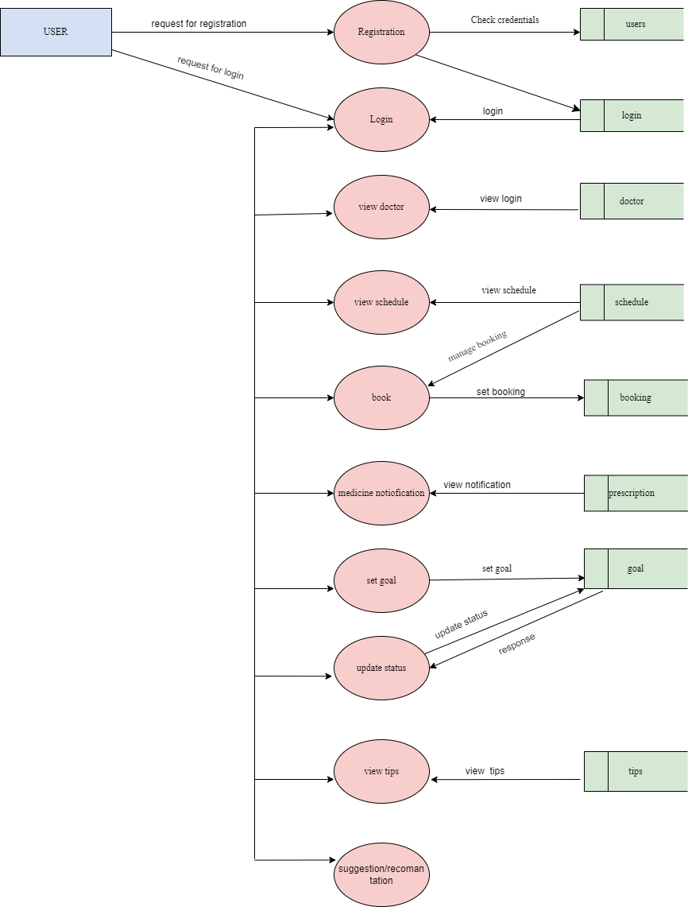
LEVEL 3

Slide 16
User story
USER STORY ID | AS A <TYPE OF USER> | I WANT TO | SO THAT I CAN
1 | User | Register | user can register
2 | User | Login | Login successful with correct username and password
3 | User | view doctor | User can view doctor
4 | User | view schedule | User can view schedule
5 | User | book | User can booking
6 | User | Medicine notification | User can view notification
7 | User | set goal | User can set goal

Slide 17
User story
USER STORY ID | AS A <TYPE OF USER> | I WANT TO | SO THAT I CAN
8 | user | update status | User can update status
9 | user | view tips | User can view tips
10 | user | suggestion/recomantation | View suggestion/recomantation

Slide 18
User Story
USER STORY ID | AS A <TYPE OF USER> | I WANT TO | SO THAT I CAN
1 | Doctor | login | Doctor can login
2 | Doctor | view schedule | Doctor can view schedule
3 | Doctor | view booking&verify | Doctor can view booking
4 | Doctor | Add prescription | Doctor can add prescription
5 | Doctor | Chat with user | Doctor can chat with user
USER STORY ID
AS A <TYPE

Slide 19
User story
USER STORY ID | AS A <TYPE OF USER> | I WANT TO | SO THAT I CAN
1 | Hospital | Login | Hospital can login
2 | Hospital | Add&manage doctor | Hospital can add&manage doctor
3 | Hospital | Add schedule | Hosptal can add schedule
4 | Hospital | View user | Hospital can view user
5 | Hospital | View booking | Hospital can view booking
6 | Hospital | Tips management | Hospital can manage tips

Slide 20
PRODUCT BACKLOG
ID | NAME | PRIORITY
1 | Login | High
2 | register | High
3 | View doctor | Medium
4 | View schedule | Medium
5 | book | Medium
6 | Medicine notification | Medium
7 | Set goal | Medium

Slide 21
ID | NAME | PRIORITY
8 | update status | Medium
9 | View tips | Medium
10 | Suggestion/ recomantation | Medium
11 | View schedule | High
12 | View booking&verify | High
13 | Add prescription | Medium
14 | chat with user | Medium

Slide 22
ID | NAME | PRIORITY
15 | add&manage doctor | High
16 | Add schedule | High
17 | View user | High
18 | View booking | High
19 | Tips management | Medium

Slide 23
Project plan
USER STOTY ID | SPRINT | START DATE | END DATE | HOURS | STATUS
1 | Sprint 1 | 07/02/2023 | 28/02/2023 | 21 | completed
2
3
4
5
6 | Sprint 2 | 1/03/2023 | 15/03/2023 | 15 | completed
7
8
9
10

Slide 24
USER STOTY ID | SPRINT | START DATE | END DATE | HOURS | STATUS
11 | Sprint 3 | 07/02/2023 | 28/02/2023 | 21 | completed
12
12
14
15
16 | Sprint 4 | 1/03/2023 | 15/03/2023 | 15 | completed
17
18
19

Slide 25
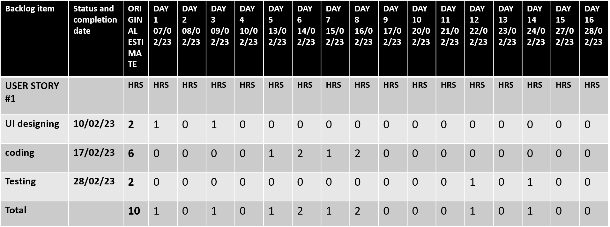
SPRINT 1

Slide 26
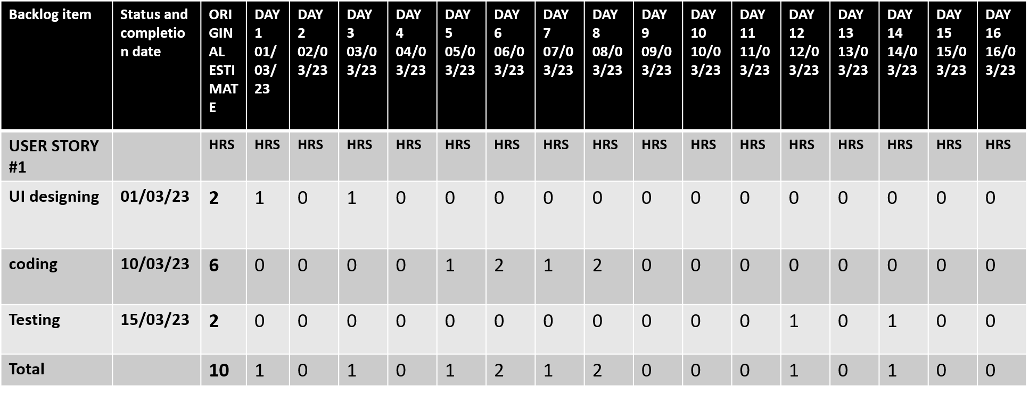
SPRINT 2

Slide 27
Thank you...

